Slide 1




DETECTING EMOTIONAL PRESSURE BY DECODING SOCIAL INTERACTIONS USING NLP MODELS
presented by : GROUP07
SUBMITTED TO:
Nirnoy Chandra Sarker (20101043)
Jennifer Abedin (20301219)
Ishrat Jahan (20301152)
Annajiat Alim Rasel (AAR)
Senior Lecturer
Adib Muhammad Amit
Research Assistant
01

Slide 2
ABSTRACT
01
Significance of Text-Based Emotion Detection (TBED)
02
Applications of Emotion Detection in AI Systems
03
Utilization of Machine Learning Models
04
Comprehensive Review and Categorization
05
Potential for Future Innovations in Emotion Detection
02

Slide 3



INTRODUCTION
1
Scope and Importance of Text-Based Emotion Detection (TBED)
2
Application Areas and Societal Impact
3
Methodological Diversity in ML Models
4
Conscious Recognition of Challenges in TBED
5
Envisioning a Future with Emotionally Intelligent AI Systems:
03

Slide 4

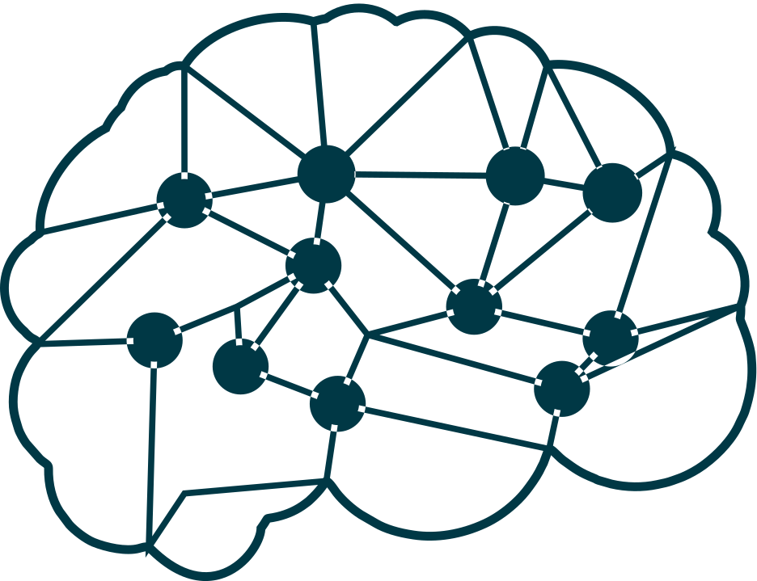





LITERATURE REVIEW
Novel Approach to Emotion Regulation in Socially Inhibited Individuals
Implications for Social Inhibition and Behavioral Challenges
Exploration of Emotion Regulation Strategies
Physiological Correlates of Emotion Regulation
Relevance to Mental Health and Intervention Strategies
04

Slide 5





METHODOLOGY
Dataset Selection
Preprocessing Techniques
Model Training and Evaluation
Machine Learning Models
05

Slide 6






EXPERIMENTS AND RESULTS
MULTI NB
RANDOM FOREST
SVM
MLP
SGD
KNN
06

Slide 7

CONCLUSION
1
2
3
Unique Approach
Effective NLP Techniques
Utilization of Existing Embedding Methods
4
5
Promising Future Studies
Dataset Development
07

